Slide 1
A simply summary of “The Workshop on Deep Learning and Computer Vision”

Slide 2
The First Topic： Some Critical Issues of Deep Learning ——XZ Wang

Slide 3
When we study Machine Learning, we have many bewildering questions. In fact, there are still a mass of aspects that are difficult to explain in Machine Learning, especially in mathematics. Professor Wang talked much about it.

Slide 4
An interesting point : There are many ways to look at machine learning, such as mathematics, engineering , technology and so on. So everyone has their own opinion.

Slide 5
1 What is Machine Learning？
Learn from experience
Use experience to do something
By model (Prediction)
According to the task and model, There are many ways to classify machine learning.

Slide 6
2 Some explanation about Machine Learning
(1) Finding common ground in your data(Finding “experience” ) is important in Machine Learning, and the model can be casually selected.
(2) Learning tasks are an extension of small sample data to large sample data.
(3) Algorithms are often designed for targeting at some specific problems, so each algorithm must have clear prerequisites. (In Machine Learning, especially in classification task, it’s crucial importance)
(4) Assumptions or Bias.
……
Notes:
一个可用模型的建立通常分那几步？ 数据预处理（通常是进行PCA降维等操作减少噪声）、模型训练（运用某些算法计算数据的一些“特征”，然后获得一些参数，使模型拟近某个函数）、任务执行（比如数据分类、目标检测等等）？是否可以大致分为这三步？

Slide 7
3 Deep Learning Limitations
(1) Why does Deep Learning work powerfully?
(2) How to choose an excellent superparameter?
(3) How to explain “Deep"?
(4) Can deep learning learn all distributions?
(5) Where is the limit of the complexity matching relationship between data volume and model?
(6) Three - layer neural network can approximate any continuous function. Why should we use “deep” neural networks?
……

Slide 8
In deep learning, there are many questions that we cannot explain. How to explain these problems and we should explain from which Angle. That's what we need to study.

Slide 9
The Second Topic： Approximation Theory in Deep Learning ——FL Cao

Slide 10
Deep learning model is essentially a mathematical model. Taking the derivation of BP Neural Network as an example, professor Cao introduces some problems in mathematical approximation of neural network. Some essential characteristics of neural network are also introduced.

Slide 11
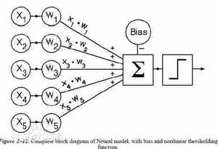
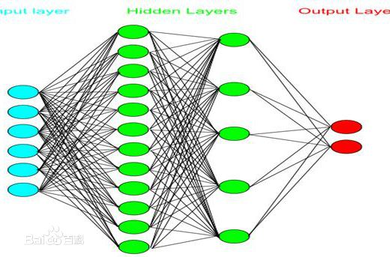
1* The Forward Artificial Neural Network
Logistic Regression model
Feedforward neural network
Perceptron Structure

Slide 12
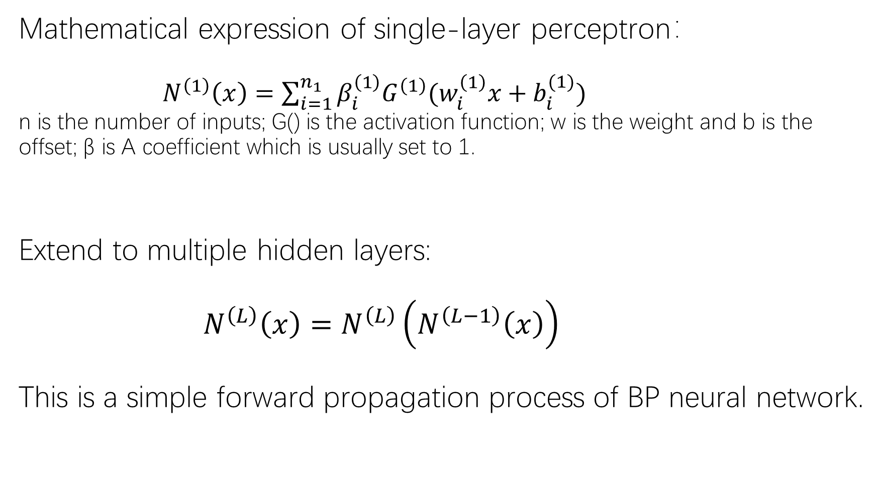
Mathematical expression of single-layer perceptron： $N^{\left(1\right)}\left(x\right)=\sum_{i=1}^{n_{1}}{β_{i}^{\left(1\right)}G^{\left(1\right)}(w_{i}^{\left(1\right)}x+b_{i}^{(1)})}$ n is the number of inputs; G() is the activation function; w is the weight and b is the offset; β is A coefficient which is usually set to 1. Extend to multiple hidden layers: $N^{\left(L\right)}\left(x\right)=$ $N^{\left(L\right)}\left(N^{\left(L−1\right)}\left(x\right)\right)$ This is a simple forward propagation process of BP neural network.

Slide 13
Basic problems of deep neural network learning
(1) Deep Neural Network research boom.
(2) Great achievements have been made.
(3) There's no good mathematical theory to back it up.
(4) The lack of theory leads to the bottleneck of research.
(5) The research of neural network involves approximation theory, probability theory, statistics, convex analysis, algorithm complexity analysis and so on.
……

Slide 14
2* Approximation of Deep Neural Networks
Q1: Basic problems and significance of deep neural network approximation
Q2: Dense problem of deep neural network approximation
Q3: The complexity of deep neural network approximation
Q4: Algorithm problem of deep neural network approximation

Slide 15
Dense problem
In 1989, Hornik proved the Universal Approximation Theorem. A multilayer neural network can approximate a continuous function of any complexity with any accuracy only by a hidden layer containing enough neurons.
Higher dimensional continuous functions can be accurately represented by simple combinations of unary functions. This conclusion was proved by the Soviet scientist komokorov in 1957. This is very similar to neural networks.
However, there is no complete proof for convolutional network

Slide 16
Complexity problem
Function construction is an important problem in approximation theory.
The minimum and maximum values of the function are approximated by an error to find a suitable network structure

Slide 17
The Third Topic： Weakly Supervised Method for Computer Vision Application ——Yi Yang

Slide 18
What is weak Supervised Learning?
The samples used in the supervised learning requirements training model are labeled.
Manual labeling costs a lot of labor and resources.
Weak supervised learning (semi-supervised learning) USES a small amount of tagged data and a large amount of untagged data to complete the network training.

Slide 19
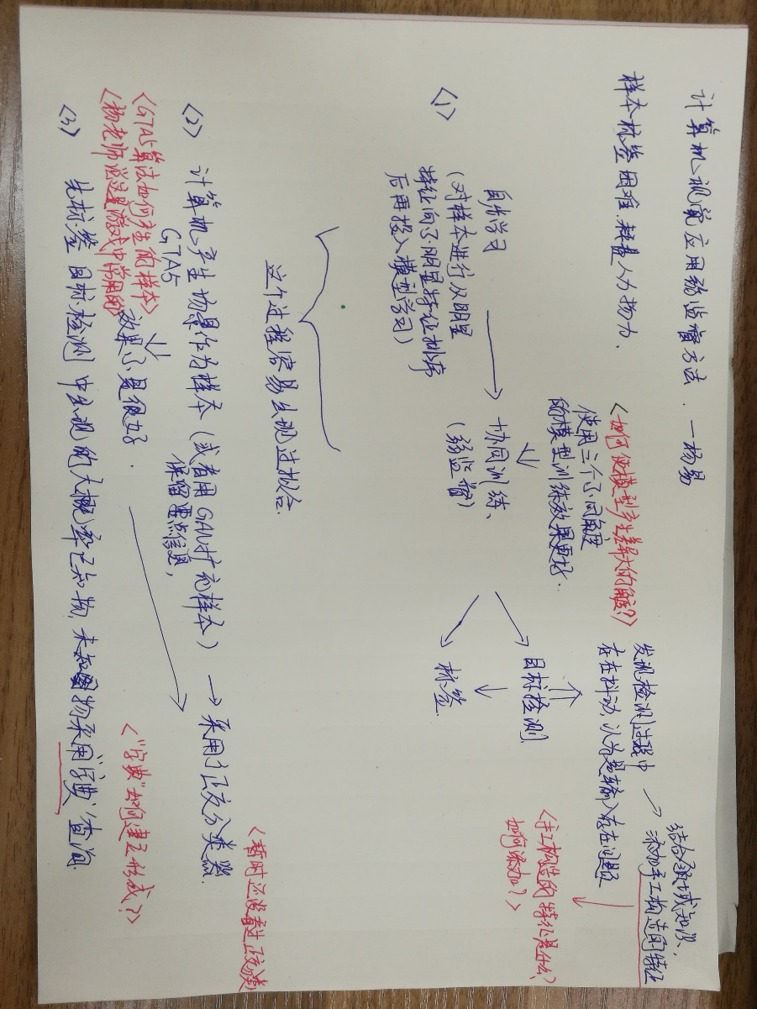

Slide 20
The Fourth Topic： Structural Deep Learning for Visual Identity and location ——WL Ouyang

Slide 21
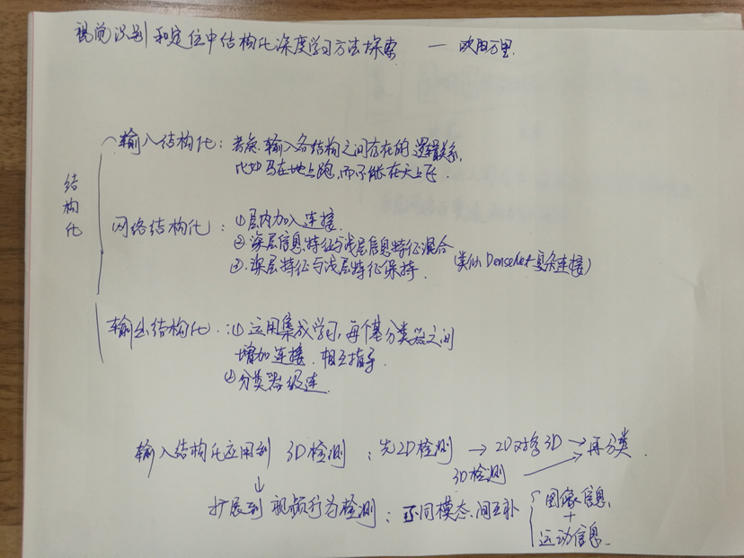

Slide 22
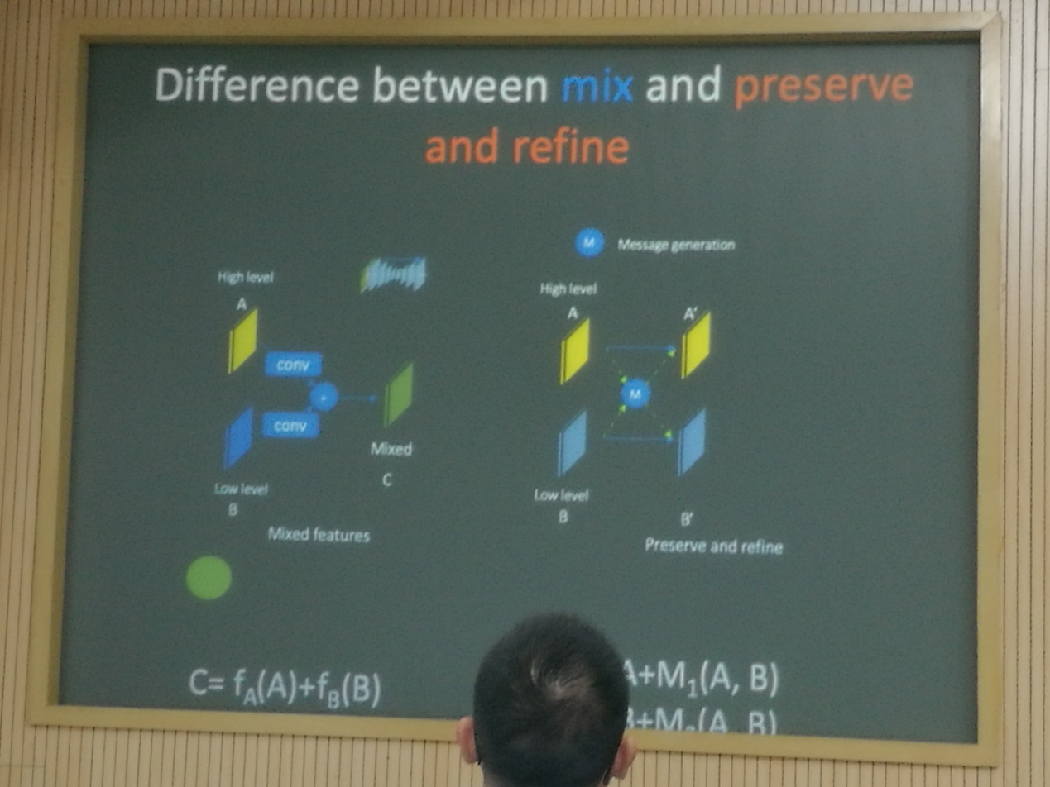

Slide 23
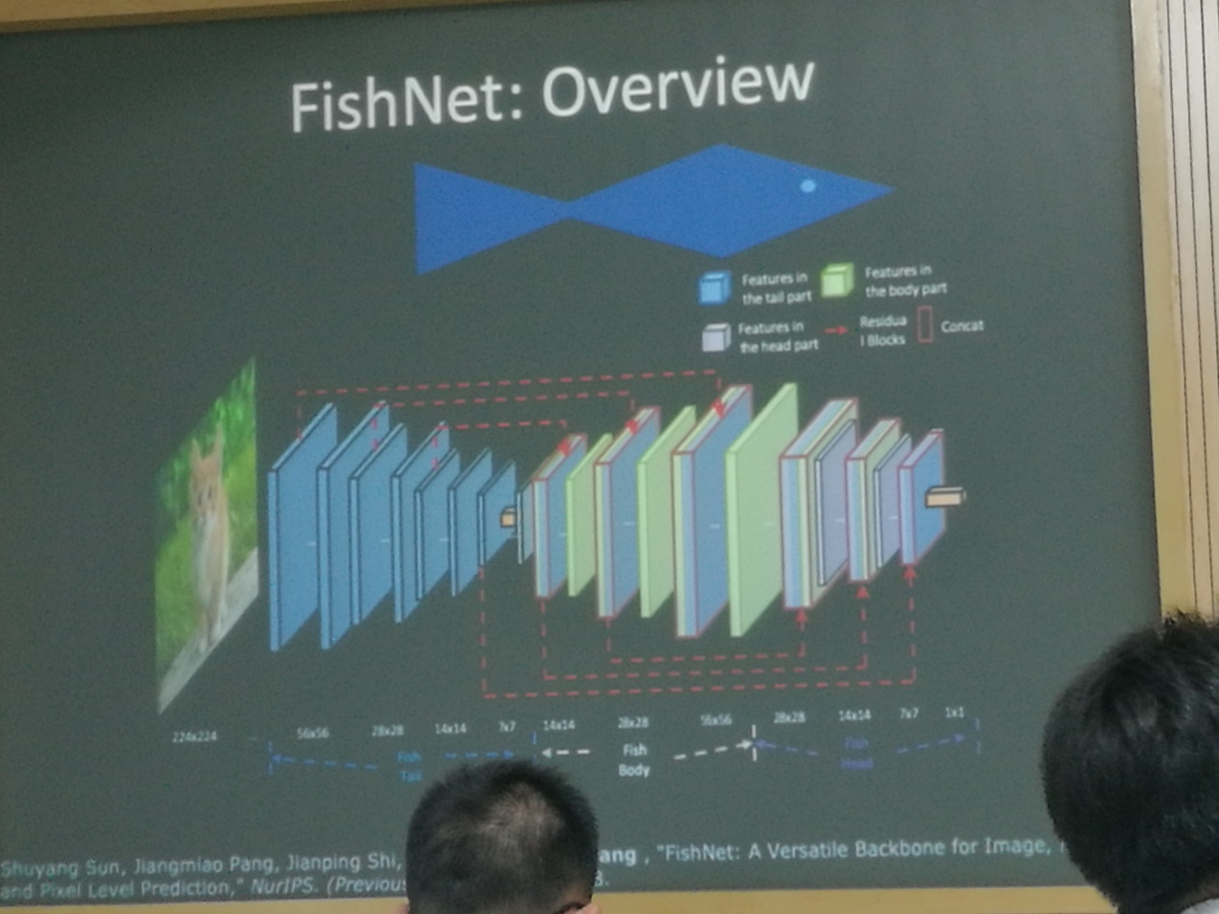

Slide 24
The Fifth Topic： Behavior Analysis in Infrared Video and Application in Wisdom Campus ——CQ Gao

Slide 25
Professor gao mainly talked about how to use infrared video for motion recognition. He also analyzes the target detection and recognition of students' behavior in the classroom.

Slide 26
（一）Infrared Video Behavior Analysis
Why study infrared video?
Because Infrared video can be observed at night it is good for privacy.
What are the main difficulties? How to Solve the Problem ?
Lack of Infrared Video Database .
Converting Visible Video into Infrared Video By GAN.

Slide 27
（二）Visual Analysis in Intelligent Campus
For the crowded monitoring images, he proposed a head detection strategy based on Adaboost and CNN algorithm
adapted pipeline
Images from classroom
Cascade adaboost detection
Raw Proposals
CNN classification
results

Slide 28
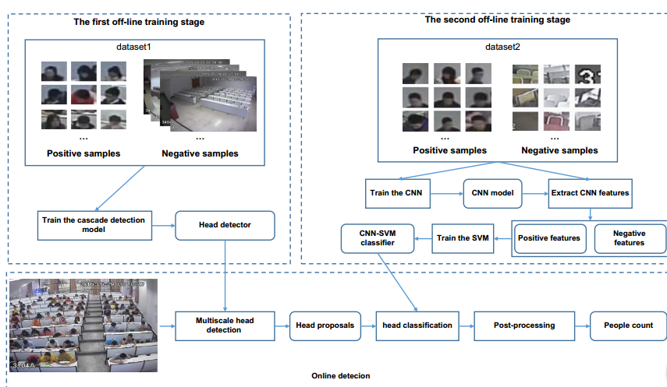
Overview of framework

Slide 29
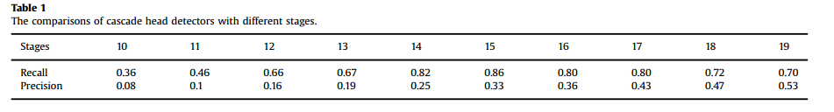
How many stages should be used for the cascade detector.
we can observe that the detector with 15 stages has the highest recall rate, with a precision of 0.33 which is comparatively acceptable. Thus, in this paper, we use the cascade detector with 15 stages to detect head candidate regions .

Slide 30
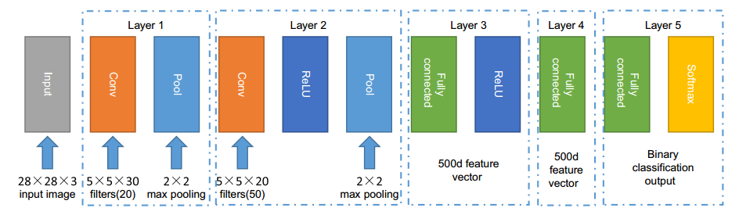
CNN architecture

Slide 31
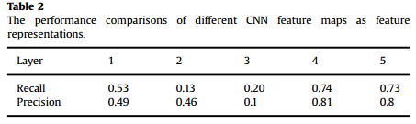
Which layer should be used to extract feature
We choose the output of Layer 4 as the feature representation in this paper.

Slide 32
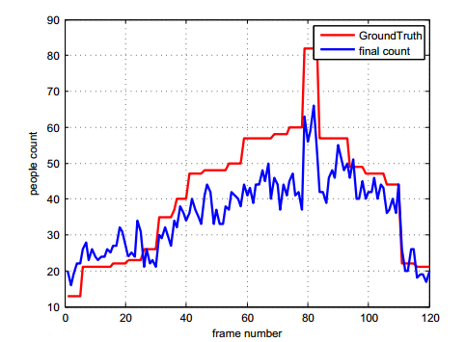
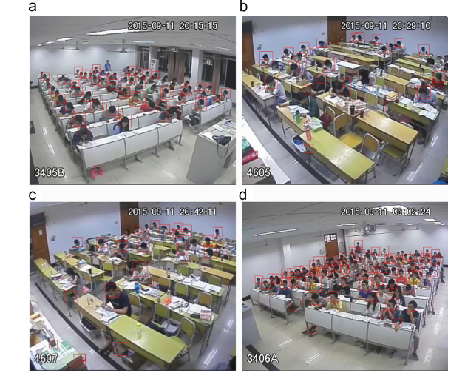
Results on our real surveillance dataset
When the people becomes dense, the performance begins to degrade because of heave occlusion.

Slide 33
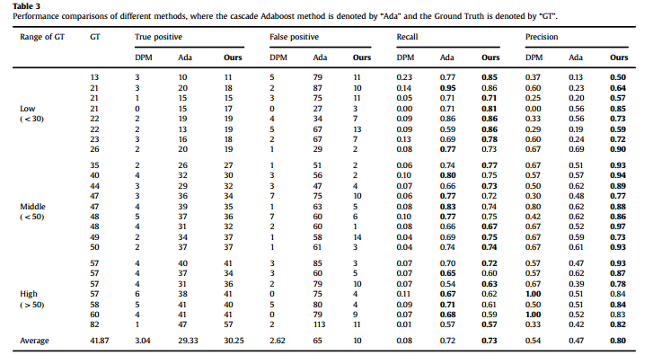

Slide 34
What are the main difficulties? How to Solve the Problem ?
It is worth noting that some bags are easily recognized as heads by the CNNSVM classifier since they are very similar to heads if just focusing on the local region. However, if we add bag samples into the negative sample set to train the CNN-SVM classifier, this problem would be relived to some extent .

Slide 35
The Sixth Topic： From Self-Paced Learning to Meta learning ——DY Meng

Slide 36
What is the Self-Paced Learning?

Slide 37
The Seventh Topic： Learning CNN——based Image Compression ——WM Zuo

Slide 39
The Eighth Topic： Learning Video Representation for Human Internations Understanding ——LC Zhu

Slide 41
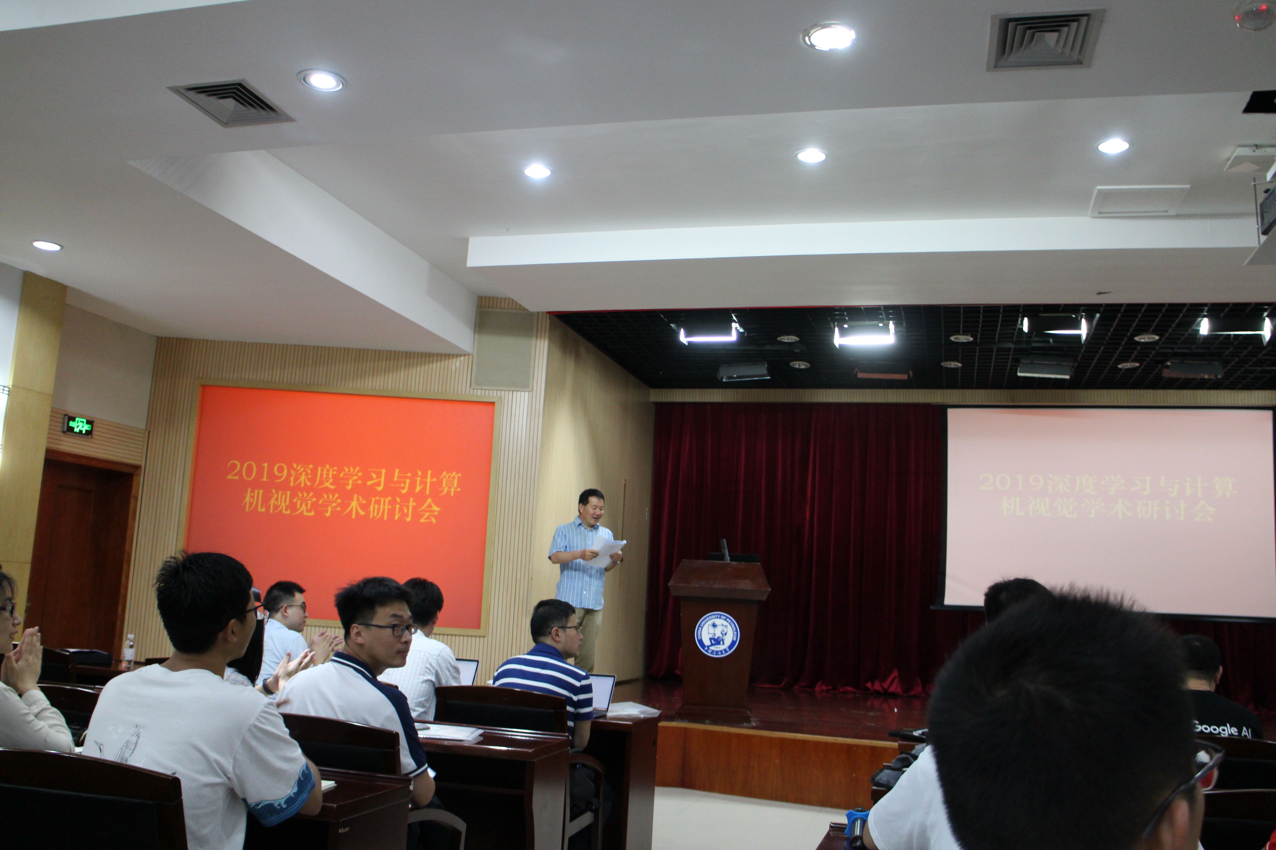
This is me.

Slide 42
Thanks

